Slide 1
Meet Flask and Django
Notes:
[Mandatory Slide] This would be the introduction slide of the topic that you are covering in this subsection.
When this slide plays, you could talk about the main aim that we’d be covering in this video.

Slide 2
In this Video, we are going to take a look at…
Flask
Django
Comparison between Flask and Django
Notes:
[Mandatory Slide]
Before the start of the video, we’d like to highlight what are important topics or pointers that we’d be covering in this video. This slide would immediately follow the intro/name slide. This would just be say 2-3 points for the viewers to know what they are getting into.

Slide 3

Flask (1/2)
Flask (http://flask.pocoo.org/) is a “microframework” for Python. It provides a minimal set of functionalities to support the development of simple web applications
Flask features:
URL routing via Python decorators to Python functions
HTML templating via the Jinja2 templating library
a development webserver (Werkzeug)
a rich set of extensions: http://flask.pocoo.org/extensions/
Flask does not:
feature any Object-Relational-Mapper
feature user authentication/authorization
impose any convention or structure to your app
… then, per se, it’s not even a MVC framework!
Notes:
[Mandatory Slide]
Before the start of the video, we’d like to highlight what are important topics or pointers that we’d be covering in this video. This slide would immediately follow the intro/name slide. This would just be say 2-3 points for the viewers to know what they are getting into.

Slide 4
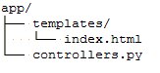
Flask (2/2)
A simple web app in Flask
<html><head><title>Test</title></head>
<body>Hello!</body></html>
from flask import Flask, render_template
app = Flask(__name__)
@app.route('/')
def home():
return render_template(‘index.html')
if __name__ == '__main__':
app.run(debug=True)
Run with: python controllers.py and head to http://localhost:5000/ ...
Notes:
[Mandatory Slide]
Before the start of the video, we’d like to highlight what are important topics or pointers that we’d be covering in this video. This slide would immediately follow the intro/name slide. This would just be say 2-3 points for the viewers to know what they are getting into.

Slide 5
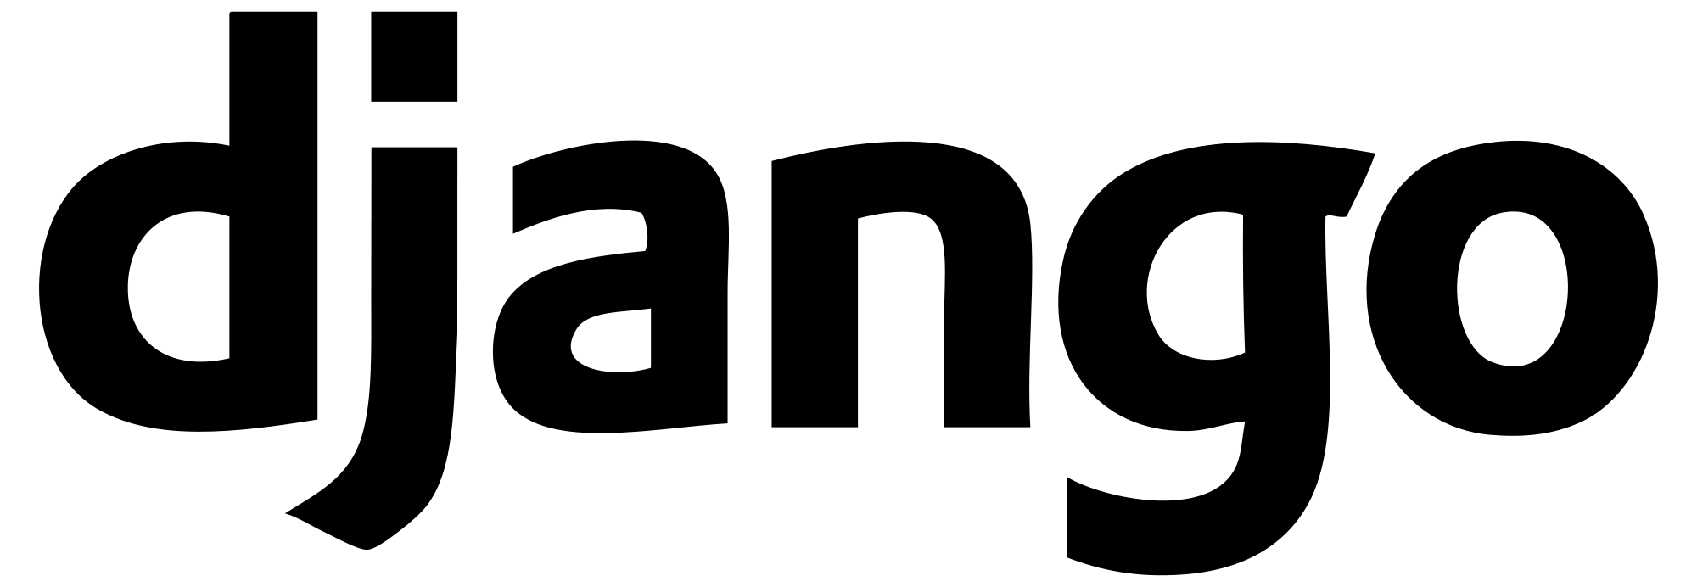
Django (1/2)
Django (https://www.djangoproject.com/) is a “battery included” MVC framework: it provides almost all the common functionality that one needs for web development:
URL routing
User Authentication and Authorization
A template engine based on the Django template language
An Object-Relational Mapper (Django ORM)
Security features (eg. form validation, SQL injection protection, ...)
A development webserver
An administration panel
A command-line helper (manage.py)
Django aims to generate as much boilerplate code as possible so that you can focus on the most valuable parts of your web app. Django actually layouts your code project’s structure for you and expects you to follow it
Notes:
[Mandatory Slide]
Before the start of the video, we’d like to highlight what are important topics or pointers that we’d be covering in this video. This slide would immediately follow the intro/name slide. This would just be say 2-3 points for the viewers to know what they are getting into.

Slide 6
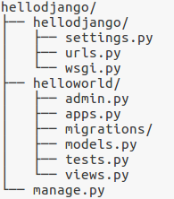
Django (2/2)
To start up a Django project, run on the command line: django-admin startproject <proj-name>
From inside the project, create a new for it: python manage.py startapp <app-name>
Project-wide settings
URL routes
Project
App
Models (as per MVC)
Controllers (as per MVC)
Management script
Run with: python manage.py runserver, your app is available under http://127.0.0.1:8000
Notes:
[Mandatory Slide]
Before the start of the video, we’d like to highlight what are important topics or pointers that we’d be covering in this video. This slide would immediately follow the intro/name slide. This would just be say 2-3 points for the viewers to know what they are getting into.

Slide 7
Comparison between Flask and Django
Constraints | No constraints imposed | Imposes a base app structure
Feature set | Minimal (notably lacks out-of-the-box ORM and Authentication support) | Very rich
Framework complexity | Lightweight, easy to learn | Heavyweight, steeper learning curve
Community support | Lots of extensions, strong user community | Strong user community (due to its longevity)
Style | Aims at simplicity, flexibility and fine-grained control | Aims to save yourself as much coding as possible
Overall | OK for small projects (eg. static sites, APIs) or when you need complete control over your app | OK for larger projects (eg. content-oriented sites and web apps, such as blogs)
Notes:
[Mandatory Slide]
Before the start of the video, we’d like to highlight what are important topics or pointers that we’d be covering in this video. This slide would immediately follow the intro/name slide. This would just be say 2-3 points for the viewers to know what they are getting into.

Slide 8
Summary
Flask
Django
Comparison between Flask and Django
Notes:
[Mandatory Slide]
Before the start of the video, we’d like to highlight what are important topics or pointers that we’d be covering in this video. This slide would immediately follow the intro/name slide. This would just be say 2-3 points for the viewers to know what they are getting into.

Slide 9
Build a simple static website
using Flask and Bootstrap
Next Section
Notes:
[Mandatory Slide]
Here the name of the next section needs to be mentioned. The narration as you guessed it would be just letting the viewer know what we’d be taking over next! ☺

